Slide 1
ORB-SLAM 2 TEAM 10
Avinash Ayite • Abigail Twumasi • Jing Wang • Jonathan Rooney
Notes:
We wanted to talk about something different, unfortunately, someone thought otherwise so here we go. We will try to keep this presentation short – so we don’t bore you– as I believe we have heard most of these information several times already. I also believe almost –if not all – all of our questions about orb-slam 2 and 3 have been answered about now so NO Questions Prof

Slide 2
Content
Introduction
ORB-SLAM2
Bundle Adjustment
Local Mapping
Loop closure
Software Implementation
Data sets
KITTI Dataset
Nuance Car Dataset
Troubleshooting
Results
SLAM
Nuance dataset result
Notes:
Jonathan will give us a detailed review of what ORB-SLAM2 entails
Jing will take us through the system architecture, Kitti Dataset, issues we encounted and how they were finally resolved
Avinash will walk us through the sleepless nights and finally the tweaks we had to make so our collected stereo data works with the algorithm.

Slide 3
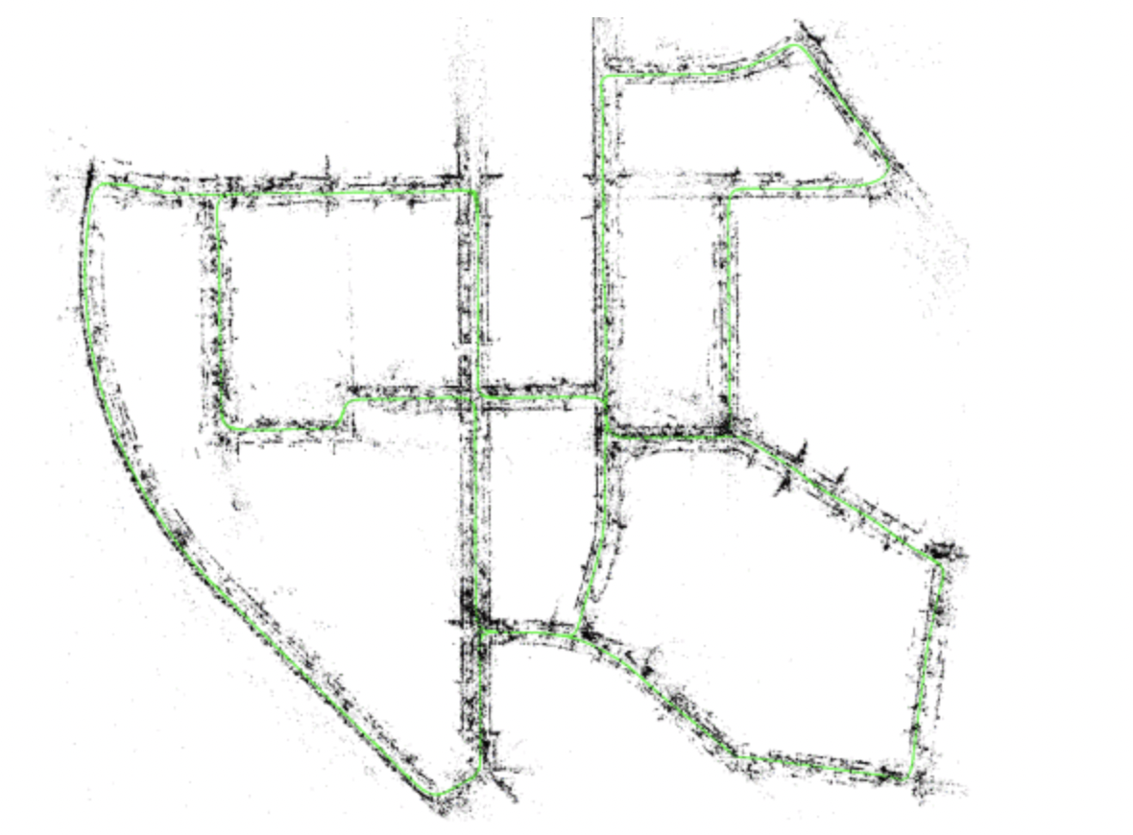
INTRODUCTION
Simultaneous Localization and Mapping (SLAM) is the process of navigating an area to build a map and simultaneously finding your location with respect to the map created. There are several SLAM techniques but the focus for our group is ORB-SLAM2. We chose ORB_SLAM2 due to the availability of a lot more resources and documentation.
The aim of this project is to
understand how ORB-SLAM2 works and use it to construct a map using stereo images from our own dataset while localizing the sensor’s (camera) position within the map.
Use KITTI dataset to test the algorithm
Collect our own data using the Nuance Car and test the algorithm
Notes:
SAY AFTER STEREO IMAGES
One of the main benefits of using stereo or RGB-D cameras is that, by having depth information from just one frame, we do not need a specific structure from motion initialization as in the monocular case. At system startup we create a keyframe with the first frame, set its pose to the origin, and create an initial map from all stereo key points.

Slide 4
ORB-SLAM2
ORB: Oriented FAST and Rotated BRIEF
A complete SLAM package designed for mono, stereo, or RGB-D cameras. Relies on two components for point tracking:
FAST (Features from Accelerated Segment Test) performs computationally efficient feature detection.
BRIEF (Binary Robust Independent Elementary Features) provides feature descriptors to allow for point matching.
The algorithm works on three main parallel threads:
a tracking thread to localize the camera with every frame, by finding feature matches to the local map and minimizing the reprojection error applying motion-only Bundle Adjustment
a local mapping thread to manage the local map and optimize it, performing local Bundle Adjustment to compute the most probable position of the camera.
a loop closing thread to detect large loops and correct the accumulated drift by performing a pose-graph optimization.
The three parallel threads launches a fourth thread to perform full Bundle Adjustment after the pose-graph optimization, to compute the optimal structure and motion solution..

Slide 5
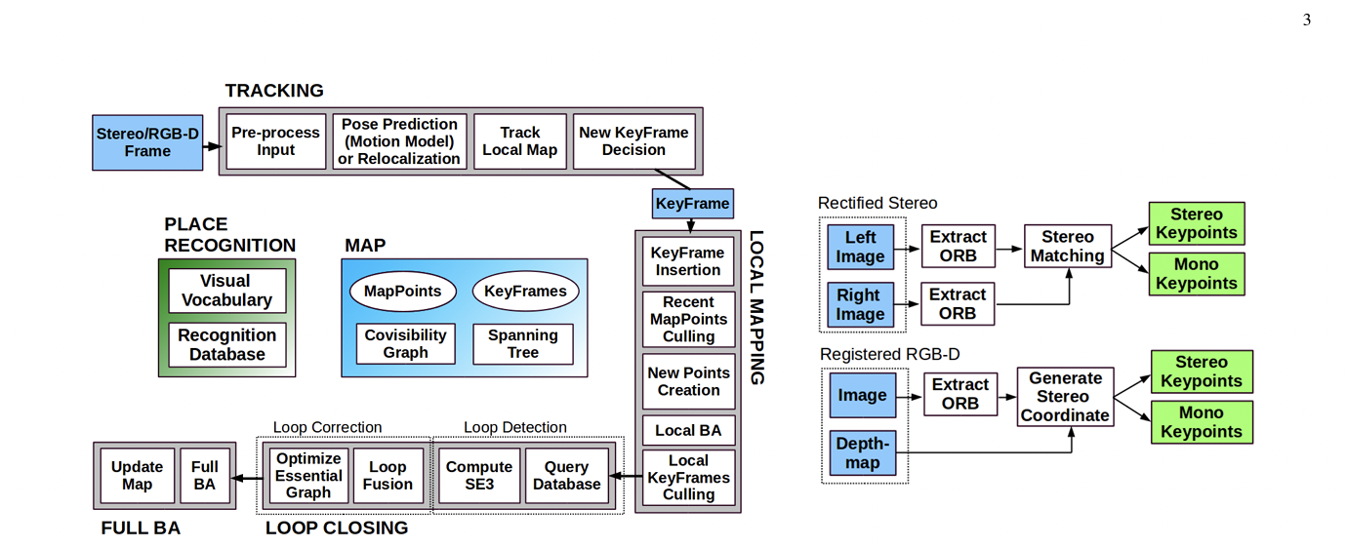
ORB-SLAM2 - Threads
Notes:
ORB-SLAM2 works on three tasks working simultaneously: tracking, local mapping & loop closing.
In its tracking part, ORB-SLAM2 does frame-by-frame feature matching and compares them with a local map to find the exact camera location in real-time. It does a motion-only bundle adjustment to minimize error in placing each feature in its correct position, also called as minimizing reprojection error.
Then comes the local mapping part. ORB-SLAM2 makes local maps and optimizes them using algorithms like ICP (Iterative Closest Point) and performs a local Bundle Adjustment to compute the most probable position of the camera.
Finally, it uses pose-graph optimization to correct the accumulated drift and perform a loop closure. It’s necessary to perform Bundle Adjustment once after loop closure, so that robot is at the most probable location in the newly corrected map. After the addition of a keyframe to the map or performing a loop closure, ORB-SLAM2 can start a new thread that performs a Bundle adjustment on the full map so the location of each keyframe and points in it get a fine-tuned location value

Slide 6
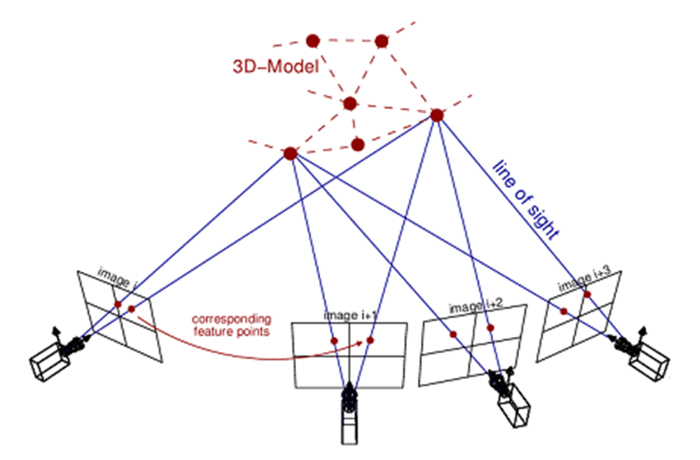
ORM_SLAM2 – Bundle Adjustment
Determines the 3D locations of corresponding feature points in multiple 2D images, in several stages:
Assigns each feature a point in 3D space, and estimates the camera poses and image planes for each image.
Reprojects the 3D points onto the image planes and calculates the error between the observed points and their 3D estimates.
Adjusts the 3D points and/or camera poses to minimize error.
ORB_SLAM2 uses several types of Bundle adjustment:
Motion-only BA, used for tracking, treats the features as stationary and find the camera pose relative to the map.
Local BA, used for local mapping, optimizes the 3D locations of new map features in the most recently added keyframe.
Full BA, used for loop closure, re-implements local BA over the entire keyframe set, now with the knowledge of where the endpoint should be.

Slide 7
ORM_SLAM2 – Tracking & Local Mapping
Tracking
Handles image pre-processing and keyframe decision-making, allowing the local mapping and loop closure threads to operate independently of input.
Includes obtaining ORB features, performing stereo matching, and determining if new keyframe is necessary.
New keyframe decisions are based on several criteria:
If at least 20 frames have passed since previous keyframe.
If the number of tracked points drops below a pre-set threshold.
Local Mapping
Creates new points to expand the map, and handles pose estimation for keyframes.
For each keyframe received, this thread:
Estimates its pose based on constant-velocity model.
Perform local bundle adjustment against prior keyframes to refine pose and new point locations.
Adds new points to the global map.
Culls unnecessary points and keyframes.

Slide 8
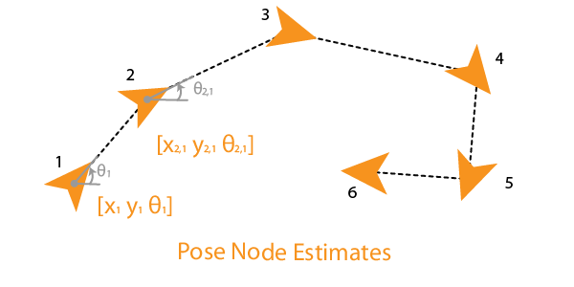
ORM_SLAM2 – Loop Closure
Handled in a separate thread, so that it can run in the background while mapping continues.
Operates in three phases:
Detection & Validation: determines if there is sufficient overlap between keyframes to indicate a loop—in practice, if three keyframes present similarly.
Correction: the loop's pose-graph is distorted to close the loop properly. The final keyframe poses are adjusted, and that adjustment is back-propagated through the loop.
Full Bundle Adjustment: the key distinguishing feature of ORB_SLAM2's loop closure. Once the pose-graph adjustment is complete, a full BA is performed on all keyframes.
Very costly process.
If a new loop is detected while the BA is running, the process is interrupted and begins anew.

Slide 9
Software Implement
We installed and run ORB-SLAM2 on Ubuntu 20.04 and after several trials and errors, it worked on all our Virtual Machines.
ORB-SLAM2 has multiple dependencies on other ROS libraries which includes Pangolin, OpenCV, Eigen3, DBoW2, and g2o.
Pangolin [0.5] library is used for the visualization and user interface.
OpenCV - OpenCV (Open-Source Computer Vision Library) is an open-source computer vision and machine learning software library. It used for image manipulation and feature extraction.
Eigen3 [3.2.X] library is used for performing mathematical operations on the Matrices.
DBoW2 is an improved version of the DBoW library, for indexing and converting images into a bag-of-word representation. It implements a hierarchical tree for approximating nearest neighbors in the image feature space and creates a visual vocabulary. It also implements an image database with inverted and direct files to index images and enables quick queries and feature comparisons
G2o is a C++ library for optimizing graph-based nonlinear error functions. This helps in solving the global BA problem in ORB-SLAM2.
ROS for data collection.

Slide 10
DATASETS

Slide 11
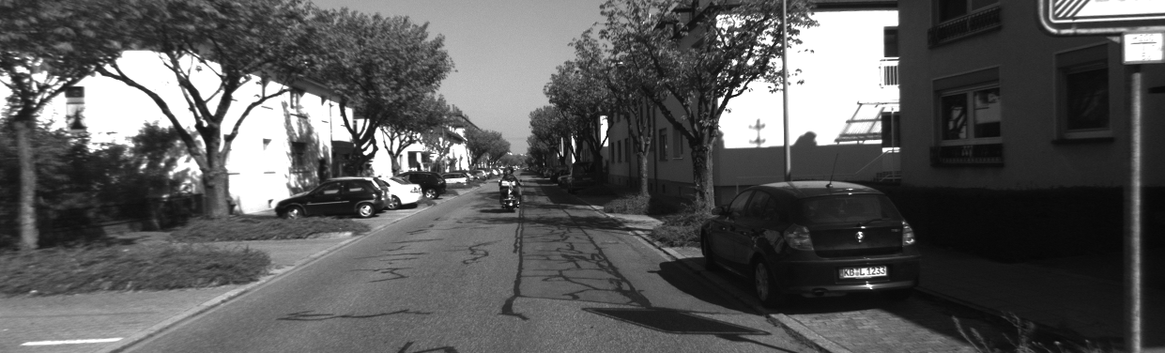
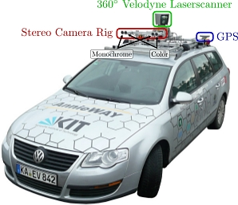
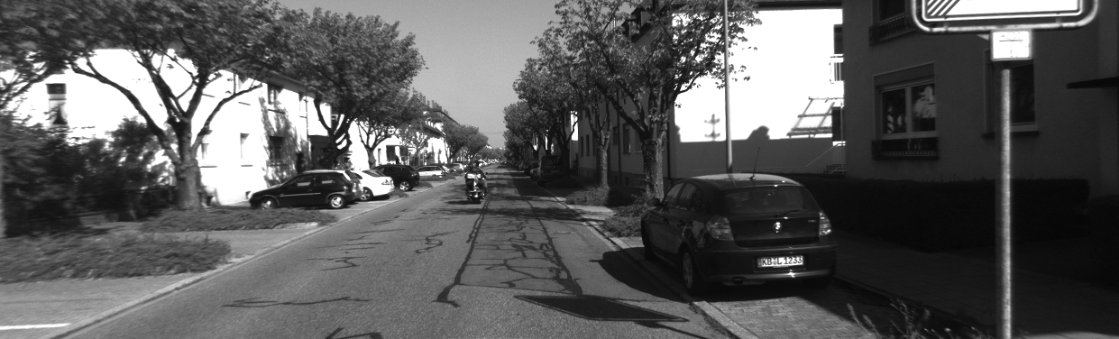
KITTI STEREO DATASET
Left Image
Right Image
Grayscale​
Urban and highway environments​
Less dynamic obstacles
Sensor:
∼54-cm baseline
10 Hz
1240×376 pixels

Slide 12
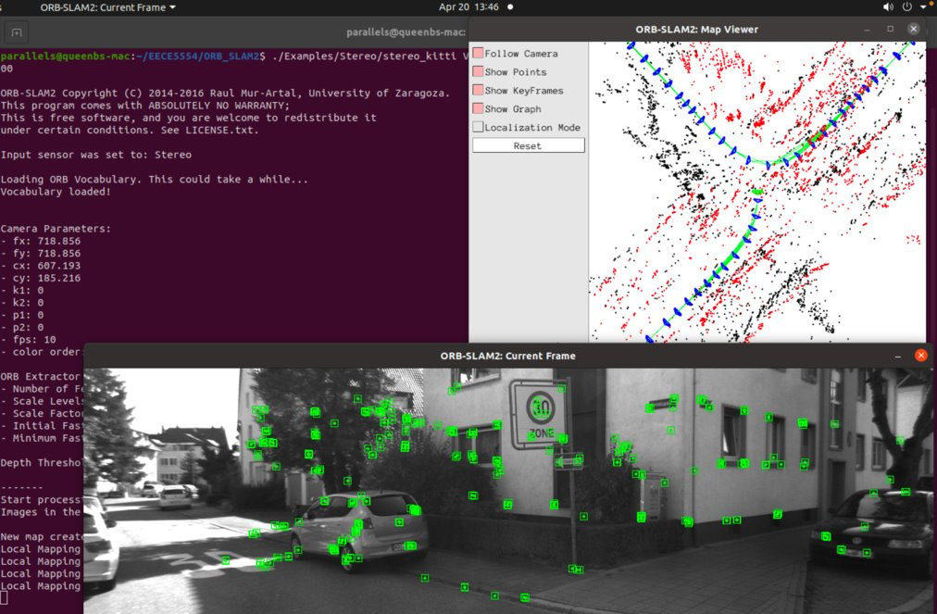
Results running ORB SLAM 2 with KITTI Stereo Data
We used the example yaml file which contains camera calibration and orb slam properties
We successfully used the stereo dataset from KITTI to test the Orbslam2 code.
Successful Kitti Video
Map of sequence 00 of kitti

Slide 13
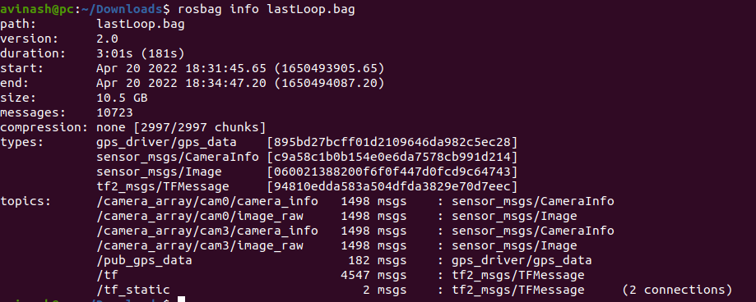
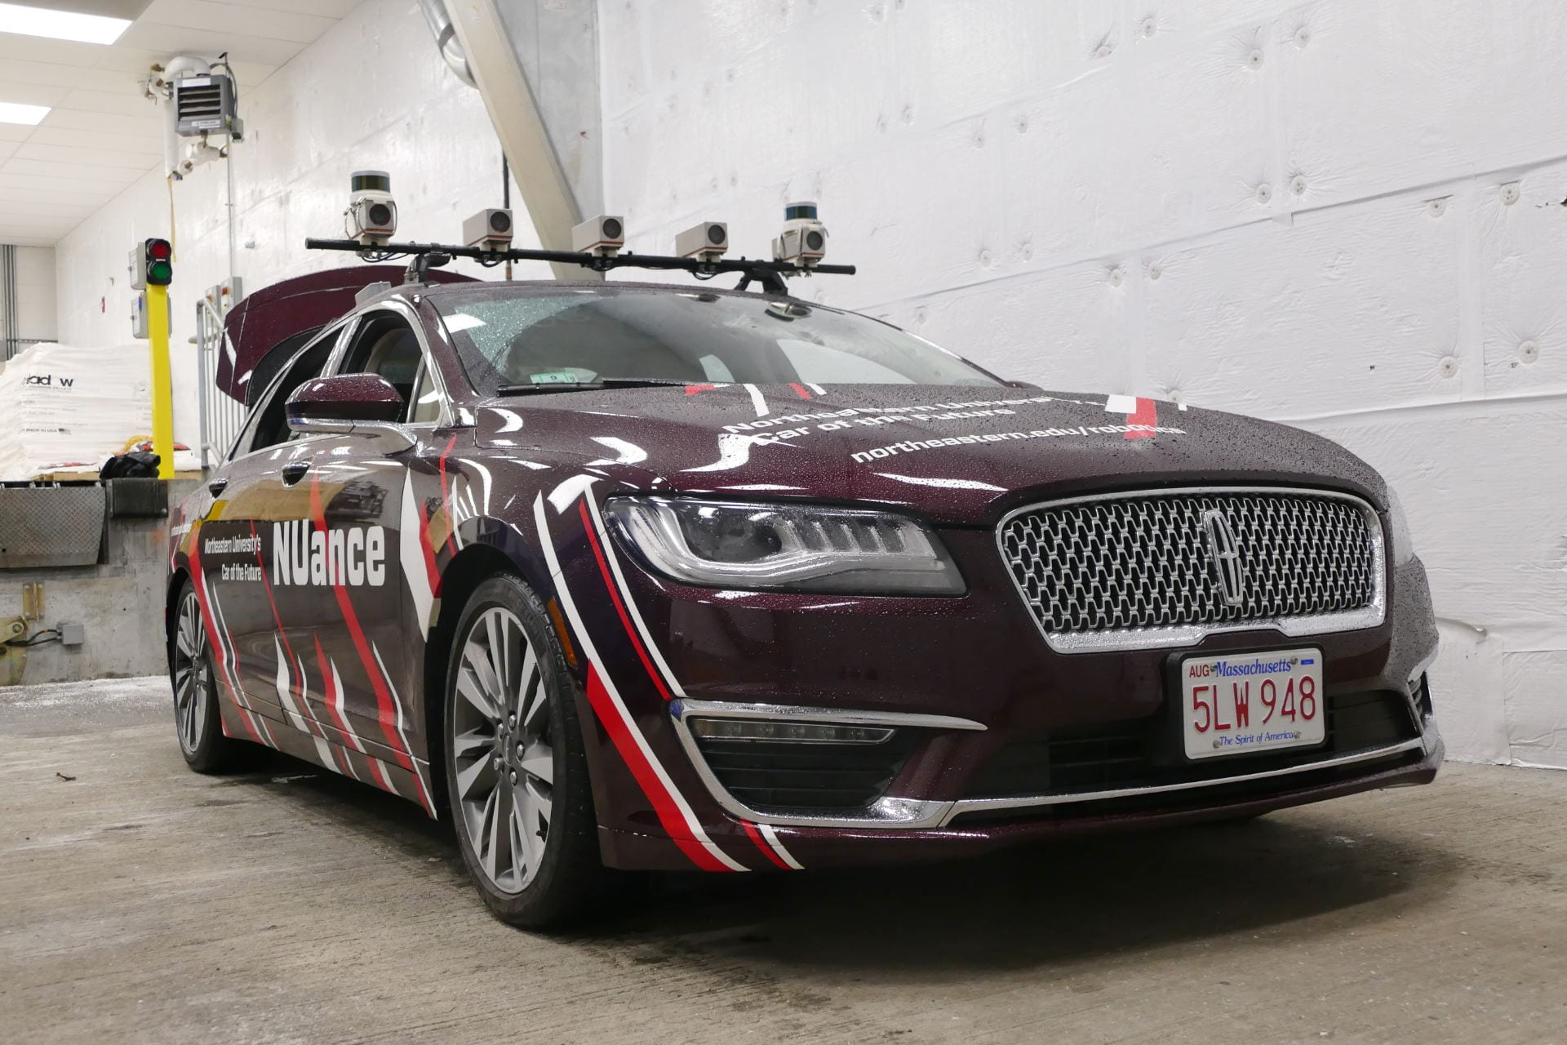
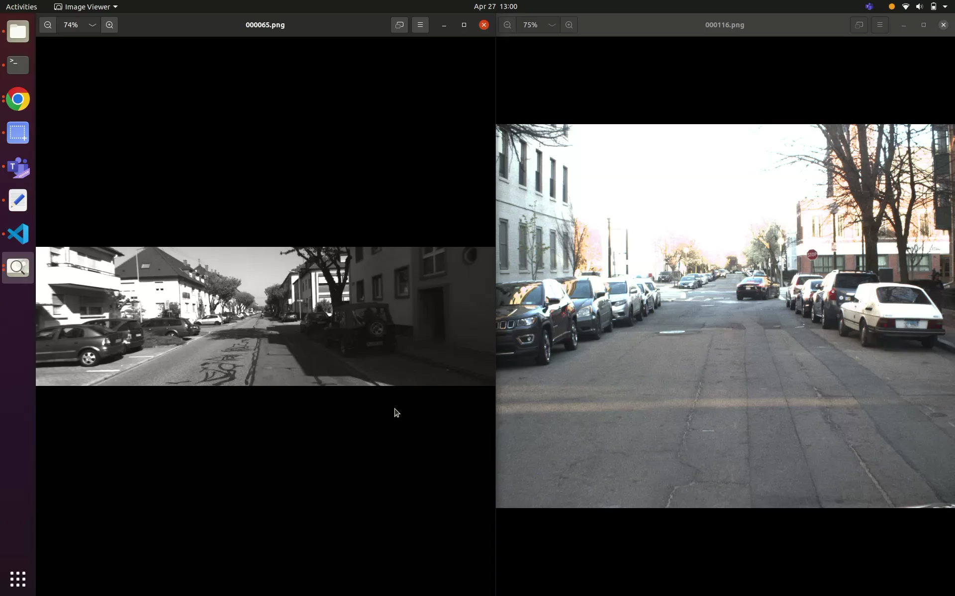
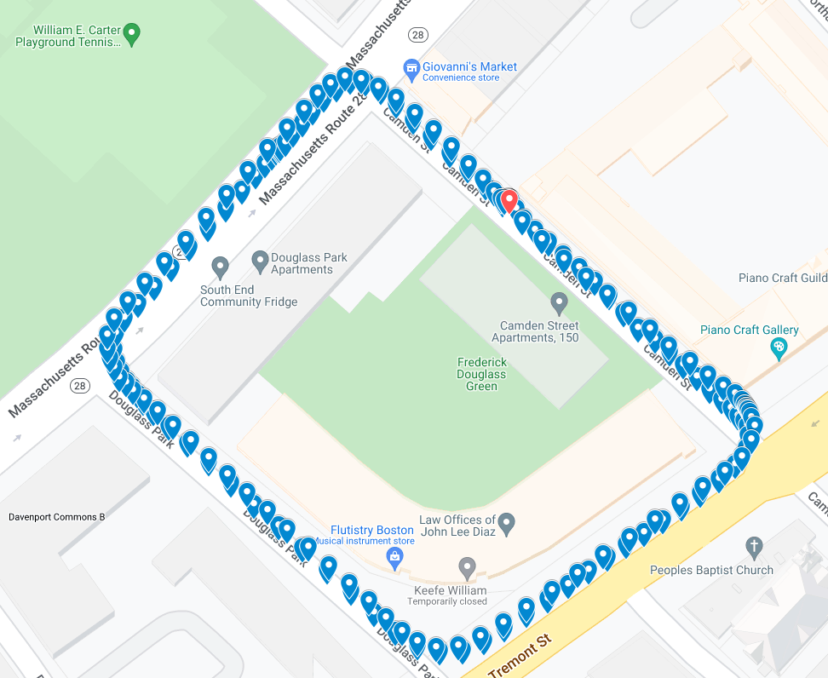
NUANCE CAR DATASET
We collected stereo dataset using Nuance car.
We drove in a loop around Tremont st and Columbus Ave.
Rosbag contains ROS topics of cam0, cam3, GPS.
Sensor: ​
98cm baseline ​
10 Hz ​
2048× 1536 pixels ​
kitti
Nuance
The collected dataset has more dynamic objects such as moving cars, pedestrians, cyclists when compared with kitti dataset

Slide 14
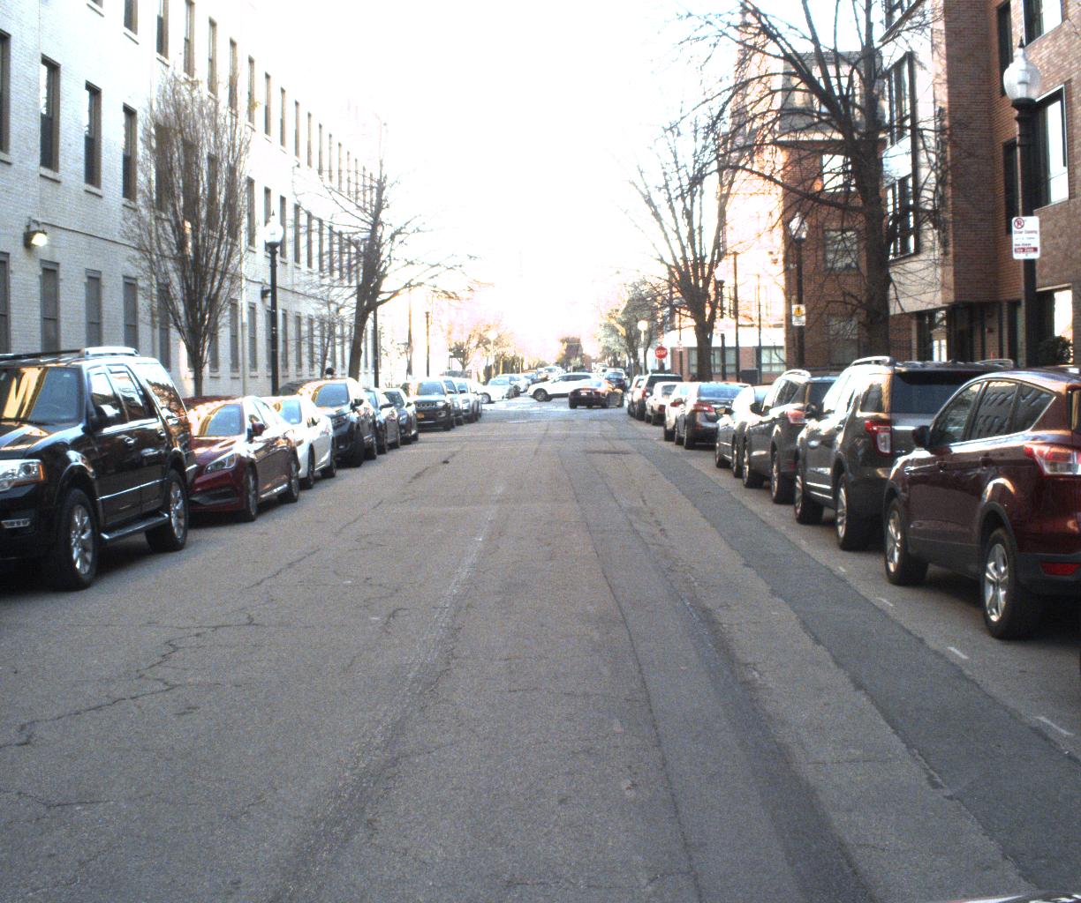
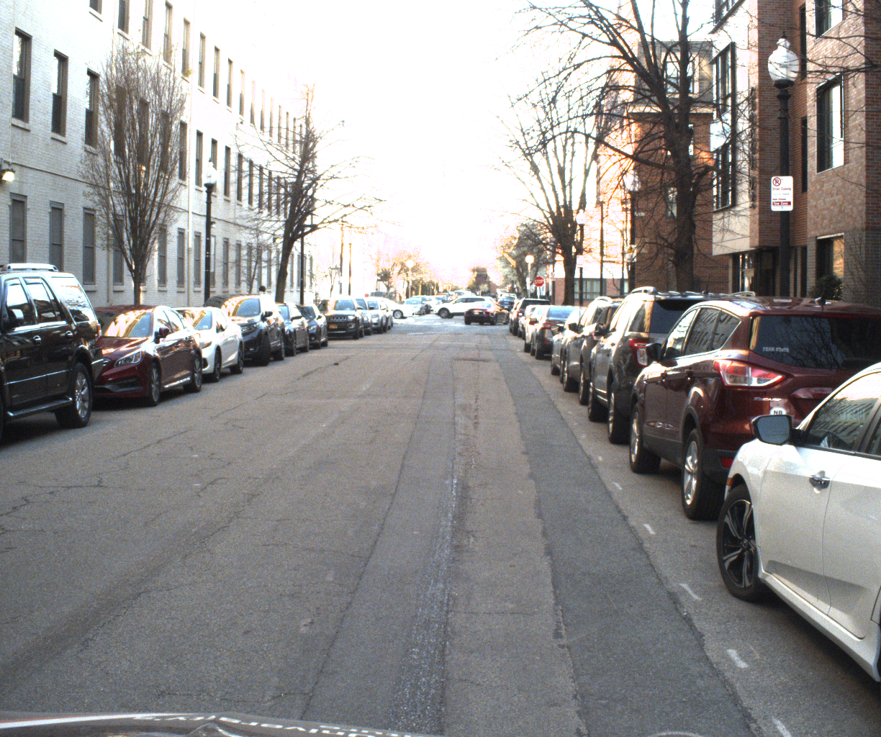
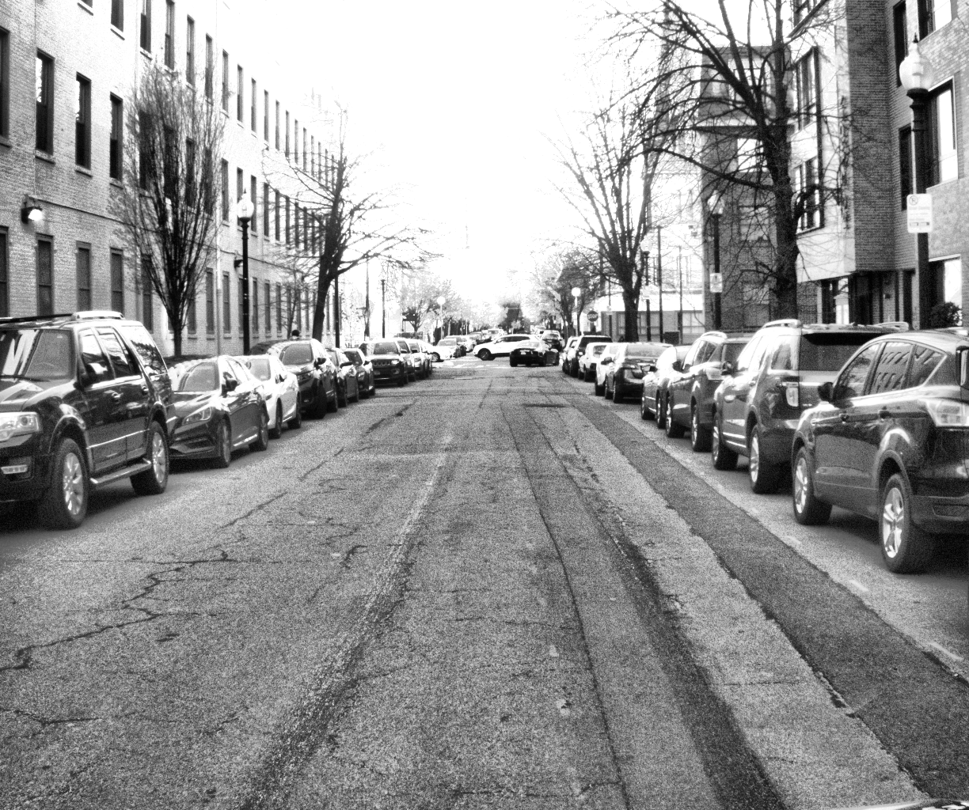
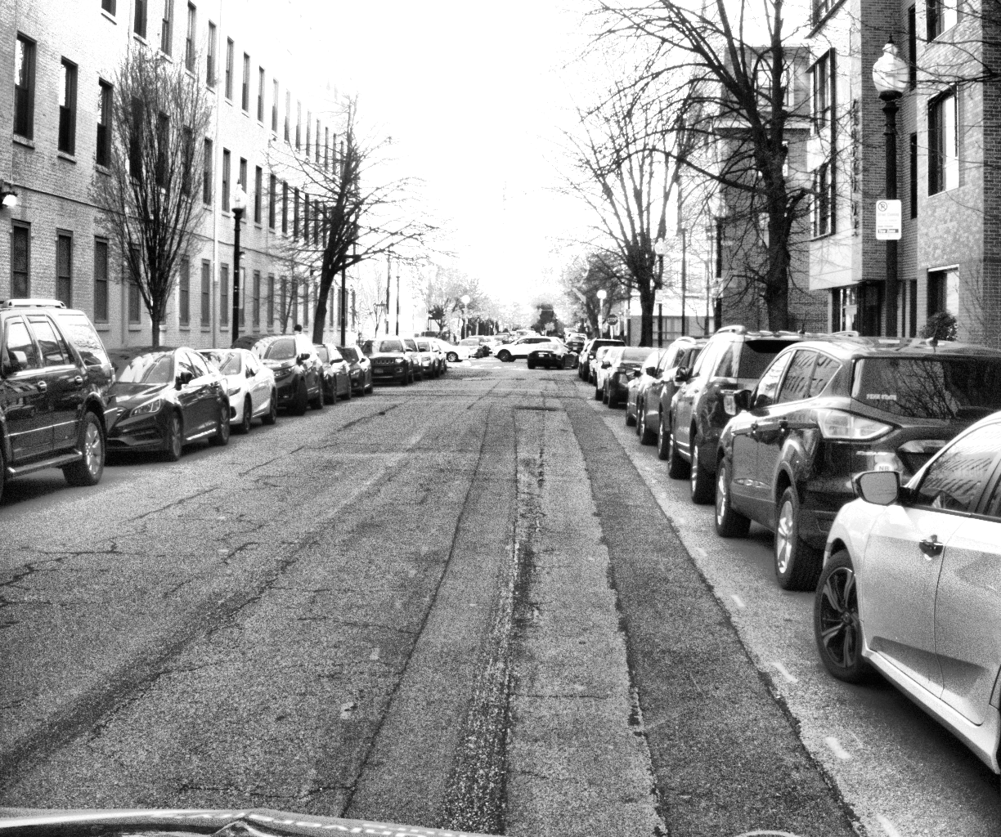
Data Preprocessing
ROS bag file data is converted into KITTI dataset format
Extract Left and Right Images (RGB Images)
Get times.txt from the rostime
Data
Image_0 #left images
Image_1 #right images
times.txt # time stamps form rosbag
Apply CLAHE
On left and right images
ROS Bag
ORBSLAM 2
cv2.createCLAHE(clipLimit = 3.0, tileGridSize=(8,8))
000000.png
000000.png
000000.png
000000.png
Clahe algorithm applied to improve the contrast of images.
Parameters cliplimit and tileGridesize are taken from ORBSLAM3 algorithm

Slide 15
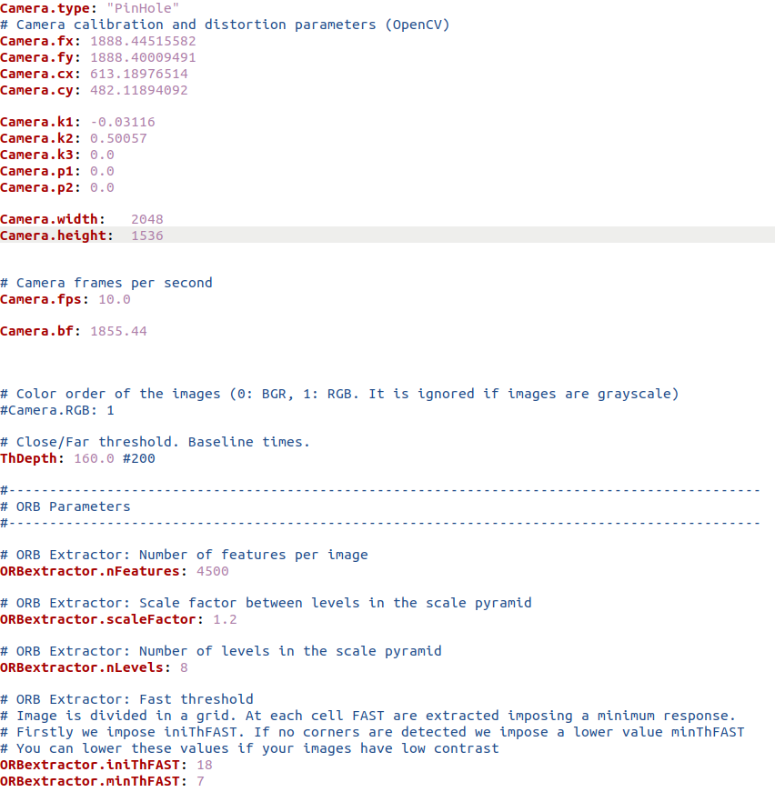
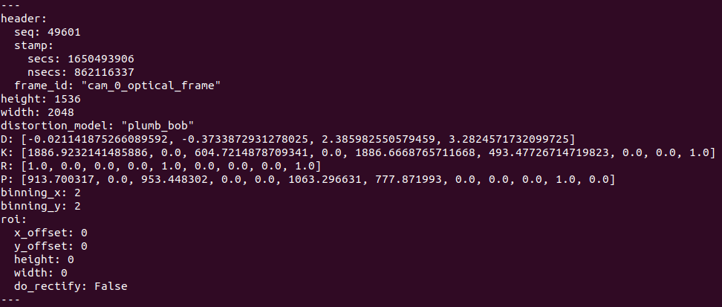
Camera and ORB SLAM Parameter Tuning
YAML file
Cam0/camera_info
Camera.bf = stereo baseline x fx
Stereo baseline cam0 and cam3 = 0.98 m
Camer.bf = 0.98x 1888.44 = 1850.44
Finetune parameter such as nFeatures, iniThFast, ThDepth

Slide 16
TROUBLESHOOTING

Slide 17
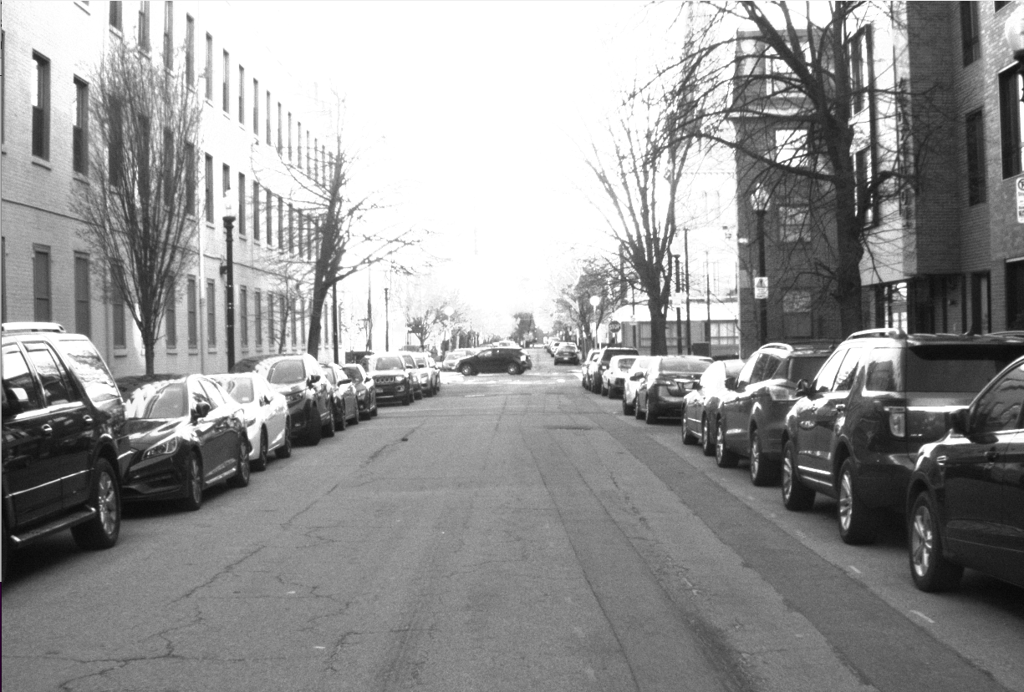
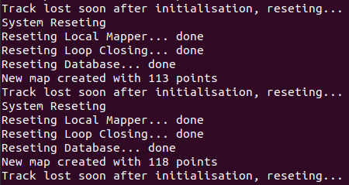
Track Lost
No features detecting
Robustness – software
Add more keyframes
Slowly rotation
Forward and backward | loop closure
Detect more features
Orb parameters in yaml: nFeatures…
Calibration - hardware
.yaml file – camera matrix
Recording light condition
GPS | IMU (orb slam 3)

Slide 18
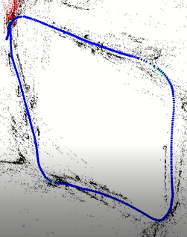
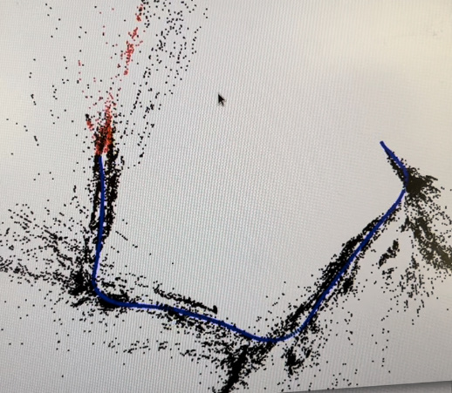
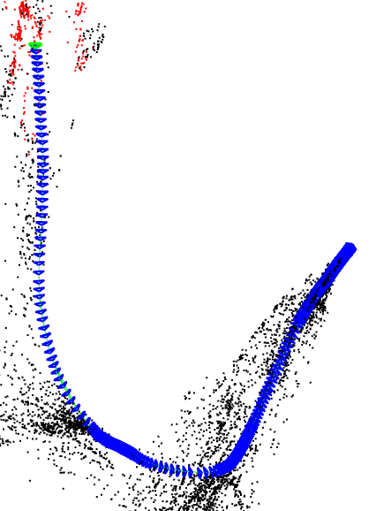
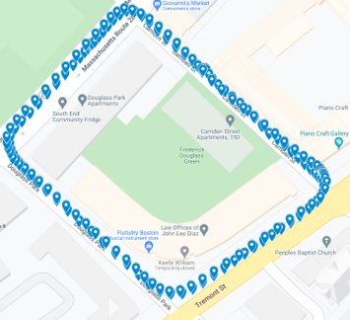
Drift
Mapping
Light Drift
Loop closure

Slide 19
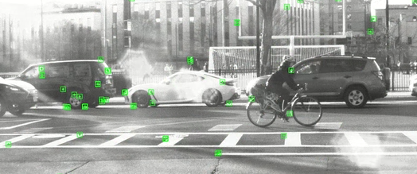
Dynamic Obstacles
Blurring
ORBextractor.iniThFAST : initial threshold to detect FAST corners.
Prior features - Features from moving obstacles

Slide 20
FINAL RESULTS

Slide 21
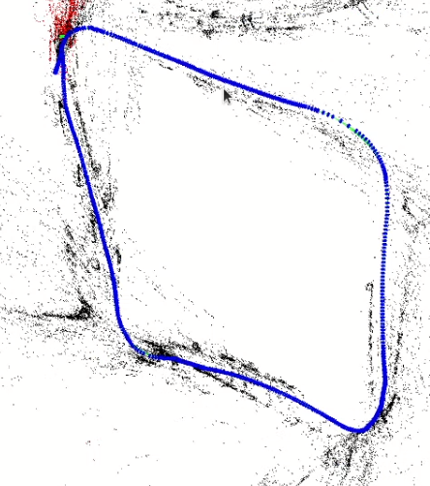
Results running ORB SLAM 2 with NUANCE Stereo Data
./Examples/Stereo/stereo_kitti # orbslam2 algo for kitti format
Vocabulary/ORBvoc.txt # vocabulary txt file
/home/avinash/Desktop/data/own_data/Sequences/KITTI00-02.yaml # yaml file
/home/avinash/Desktop/data/own_data/bagtoimg/3sec/ # left and right images
GPS
Result

Slide 22
REFERENCES
https://github.com/raulmur/ORB_SLAM2
https://roboticsknowledgebase.com/wiki/state-estimation/orb-slam2-setup/
https://ieeexplore.ieee.org/document/7946260
https://arxiv.org/pdf/1610.06475.pdf
https://paperswithcode.com/method/orb-slam2
https://arxiv.org/abs/1610.06475
https://medium.com/@sallyrobotics.blog/a-review-on-orb-slam-2-paper-3554d4fcaa7c
http://www.cvlibs.net/datasets/kitti/eval_stereo.php
https://link.springer.com/article/10.1007/s00138-017-0873-z#:~:text=A%20visual%20simultaneous%20localization%20and,by%20local%20image%20feature%20matching.
https://medium.com/@j.zijlmans/lsd-slam-vs-orb-slam2-a-literature-based-comparison-20732df431d

Slide 23

QUESTIONS

